Slide 1
Your Experience with Ethics
Take 15 minutes to think of, then summarize, a time a time as a Navy chaplain when you encountered an ethical dilemma. No need to address how you handled it. Yet.
A few of you will be chosen to brief us all on your dilemma.
This is a no judgment zone!
Remember Navy chaplain confidentiality!

Slide 2
Intermediate Leadership Course Y-5G-4307
1.3 The Ethical Leader

Slide 3
Agenda
Your Experience with Ethics
Enabling Objectives
What Is an Ethical Dilemma?
Chaplain’s Advisement Role
Case Studies
Citations
Review Objectives
Questions
Homework

Slide 4
Enabling Objectives
Effectively use white space to make your presentations appealing
Advise subordinate chaplains in making ethical decisions
Advise personnel within your command in making ethical decisions
Advise your commanding officer in making ethical decisions

Slide 5
What Is an Ethical Dilemma?
Good versus Good – A choice between two “good” actions
Good versus Bad – The choice seems easy at first glance, but...
These are bullets!! Only “titles” of the main outline of the lesson, prompts for the instructor. Instructor script goes below in the slides’ “Click to add notes” section. DO NOT PUT TEXT HERE AND READ THE SLIDES!!
The only time long text goes here is if it is something important you need the students to write in their notes!

Slide 6
What Is an Ethical Dilemma?
Add blank lines between bullets for “sparse” slides to space things out
The “enter” key is a carriage return that starts a new paragraph, or in this case, a new bullet line. Analogous to HTML <P> tag
To enter blank lines, use <SHIFT>-<ENTER> which is a line feed, not a new paragraph or bullet. Analogous to HTML <BR/> tag
You can also use in the menu bar above, Paragraph → Spacing
Above or below the current bullet or paragraph
72 points equals 1 inch

Slide 7
Case Studies
Break into groups of 4
What policies do you need to consider in your advisement? Where do you locate them?
What spiritual concerns might be present?
What ethical concerns might be present?
1 minute brief delivered by 1 group member: Summarize the advisement you would and any actions you would take.
Class-wide discussion
What did this case bring up for you?
What assumptions did you make in your advisement?

Slide 8
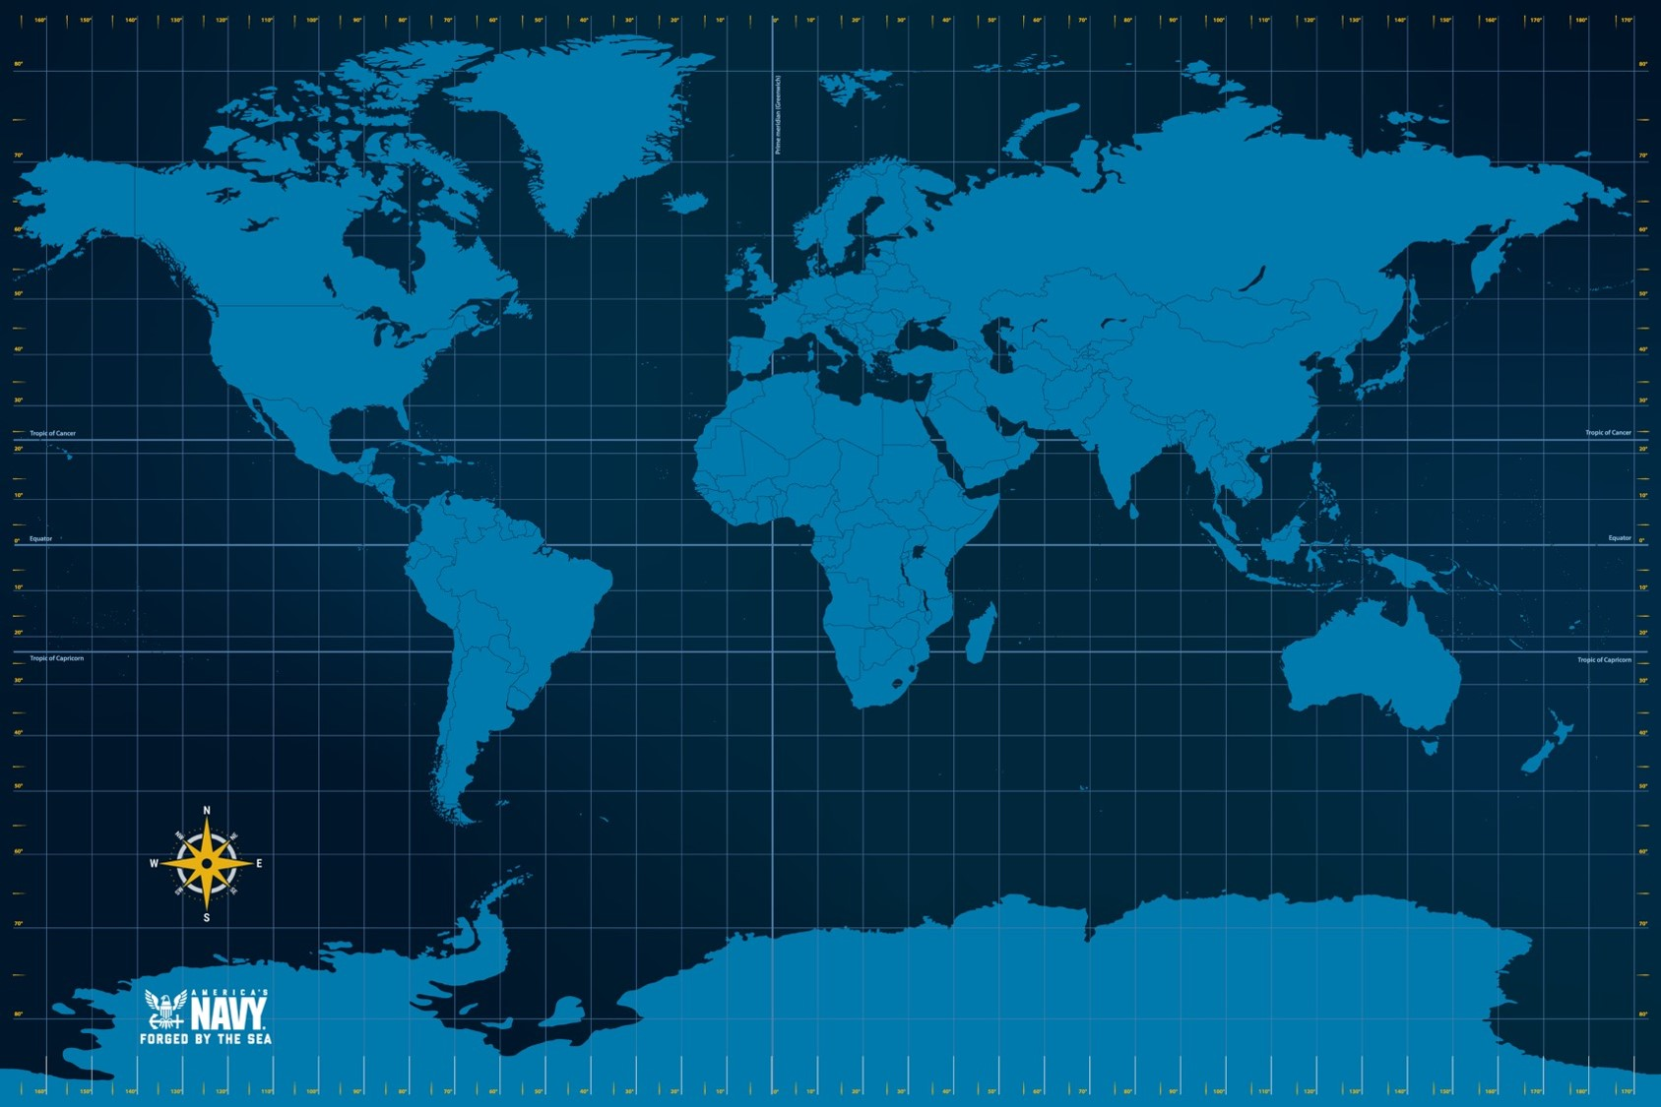
Case Studies
I added this background to demonstrate what you can do to make your PowerPoints not as boring
However, the focus in the classroom is on YOU, not this PowerPoint, so be judicious
To make this happen, use “Format Background…” by right clicking on an empty part of the slide, select “Picture or texture fill”

Slide 9
Case Study 1
A LT who you supervise has completed one shore tour at a USMC installation and one sea tour with the Navy. She recently discussed her next assignment with the detailer and was told that it would be a USMC operational billet. The detailer explained that LTs should have two operational assignments to remain competitive for promotion and to continue serving for several more years. The detailer also explained that the billets available in her PRD were USMC billets and that her PRD window was not negotiable because her relief had already been identified.
You can tell from the LT’s tone and body language that this conversation with the detailer has been difficult news from her to accept. She says, “I want to do another shore assignment. I have spent so much time away from my family in the past year, and it has not been easy. I’m concerned about the long-term impact on them if I deploy soon after arriving at my next assignment. I also realize that the time with my 3 kids is short, and I don’t want to miss these years of their life. I am the only one who can be their mom, and that’s my most important responsibility.”
Further class-wide discussion considerations:
How did the officer’s gender impact your advisement?
How do your experiences or the “lore of the Corps” impact your advisement?

Slide 10
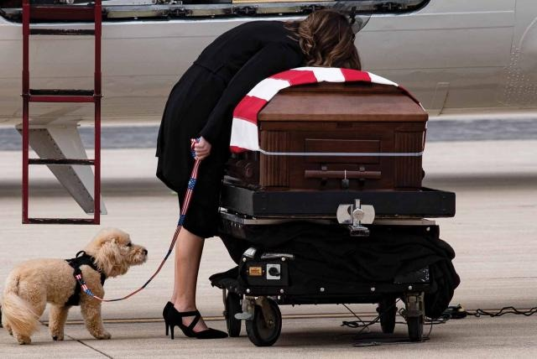
Citations
I recommend small grey colored text either below or at the bottom of an image for a citation
10 Point
White, Background 1, Darker 50%
Insert → Text Box
Amount of required detail in the citation is up to you
Proceedings, August 2024

Slide 11
Enabling Objectives
Effectively use white space to make your presentations appealing
Advise subordinate chaplains in making ethical decisions
Advise personnel within your command in making ethical decisions
Advise your commanding officer in making ethical decisions

Slide 12
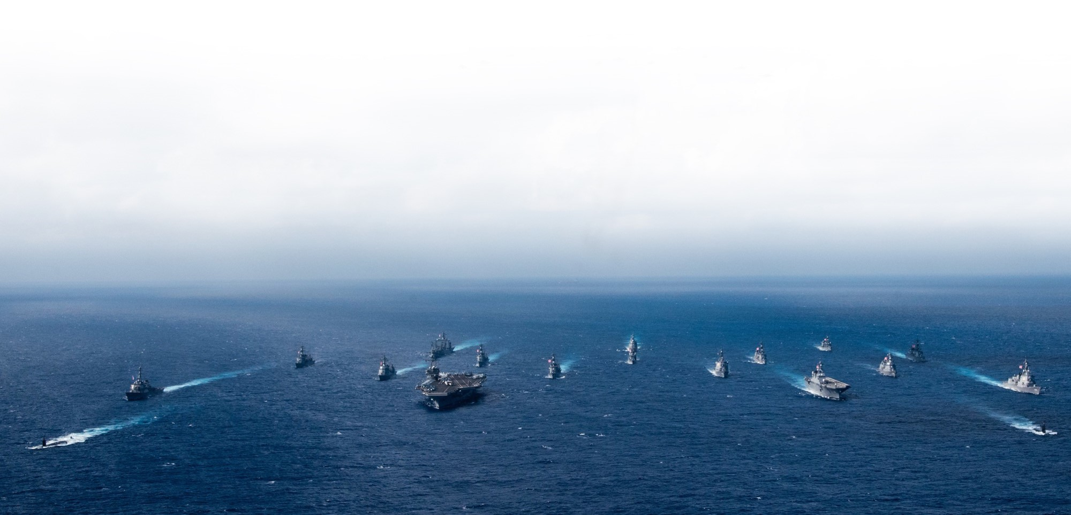
Questions
I usually keep this slide blank
To spice it up, I added the photo of the steaming fleet with “Format Background…” by right clicking on an empty part of the slide
Be wary of text color when you do this
I needed to lighten up this line for contrast

Slide 13
Homework
On the Moodle, read “The Ethical Leader Scenario 3” discussion
Post at least 1 original comment
Post at least 3 responses to others’ original comments
Discussion board rubric applies

